Slide 1
Pushdown Automata
Farhad Muhammad Riaz

Slide 2

Input TAPE
The part of an FA, where the input string is placed before it is run, is called the input TAPE. The input TAPE is supposed to accommodate all possible strings.
The input TAPE is partitioned with cells, so that each letter of the input string can be placed in each cell. The input string abbaa is shown in the following input TAPE

Slide 3




The START state
This state is like initial state of an FA and is represented by
An ACCEPT state
This state is like a final state of an FA and is expressed by
A REJECT state
This state is like dead-end non final state and is expressed by
A READ state
This state is to read an input letter and lead to some other state. The READ state is expressed by

Slide 4
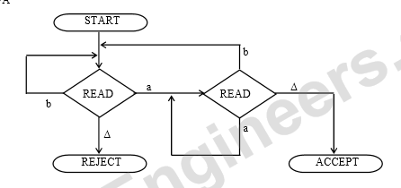

FA accepts the language of strings, expressed by (a+b)*a.
Following is the new format of the above FA

Slide 5
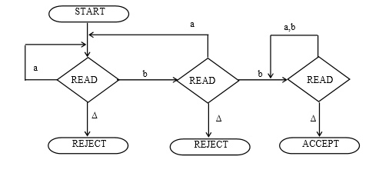

FA accepts the language expressed by (a+b)*bb(a+b)*

Slide 6
PUSHDOWN STACK or PUSHDOWN STORE PUSHDOWN STACK
is a place where the input letters can be placed until these letters are refered again. It can store as many letters as one can in a long column. Initially the STACK is supposed to be empty i.e. each of its storage location contains a blank.

Slide 7
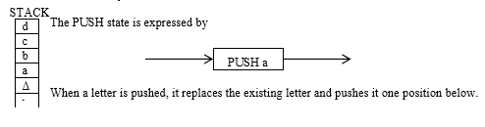
PUSH
A PUSH operator adds a new letter at the top of STACK, for e.g. if the letters a, b, c and d are pushed to the STACK that was initially blank, the STACK can be shown as

Slide 8
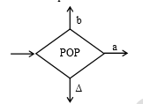
POP and STACK POP
is an operation that takes out a letter from the top of the STACK.
The rest of the letters are moved one location up.
POP state is expressed as

Slide 9
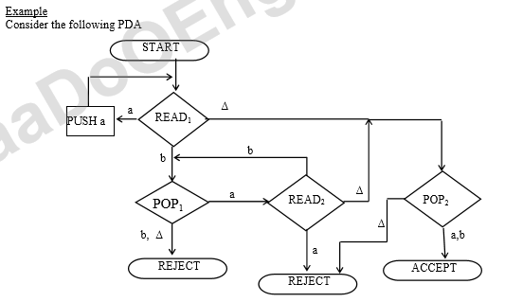

Slide 10

The string aaabbb is to be run on this machine.
Before the string is processed, the string is supposed to be placed on the TAPE and the STACK is supposed to be empty as shown below

Slide 11







Slide 12
Pushdown Automaton -- PDA
Input String
Stack
States

Slide 13
Initial Stack Symbol
Stack
Stack
stack
head
top
bottom
special symbol
Appears at time 0

Slide 14
The States
Input
symbol
Pop
symbol
Push
symbol

Slide 15
input
stack
top
Replace

Slide 16
input
stack
top
Push

Slide 17
input
stack
top
Pop

Slide 18
input
stack
top
No Change

Slide 19
Empty Stack
input
stack
empty
Pop
top
The automaton HALTS
No possible transition after

Slide 20
A Possible Transition
input
stack
Pop
top

Slide 21
Non-Determinism
PDAs are non-deterministic
Allowed non-deterministic transitions

Slide 22
Example PDA
PDA

Slide 23
Basic Idea:
Push the a’s
on the stack
2. Match the b’s on input
with a’s on stack
3. Match
found

Slide 24
Execution Example:
Time 0
Input
Stack
current
state

Slide 25
Time 1
Input
Stack

Slide 26
Time 2
Input
Stack

Slide 27
Time 3
Input
Stack

Slide 28
Time 4
Input
Stack

Slide 29
Time 5
Input
Stack

Slide 30
Time 6
Input
Stack

Slide 31
Time 7
Input
Stack

Slide 32
Time 8
Input
Stack
accept

Slide 33
A string is accepted if there is
a computation such that:
All the input is consumed
AND
The last state is an accepting state
At the end of the computation,
we do not care about the stack contents
(the stack can be empty at the last state)

Slide 34
The input string
is accepted by the PDA:

Slide 35
In general,
is the language accepted by the PDA:

Slide 36
Rejection Example:
Time 0
Input
Stack
current
state

Slide 37
Rejection Example:
Time 1
Input
Stack
current
state

Slide 38
Rejection Example:
Time 2
Input
Stack
current
state

Slide 39
Rejection Example:
Time 3
Input
Stack
current
state

Slide 40
Rejection Example:
Time 4
Input
Stack
current
state

Slide 41
Rejection Example:
Time 4
Input
Stack
reject
current
state

Slide 42
The input string
is rejected by the PDA:

Slide 43
A string is rejected if there is
no computation such that:
All the input is consumed
AND
The last state is an accept state
At the end of the computation,
we do not care about the stack contents

Slide 44
Another PDA example
PDA

Slide 45
Basic Idea:
Push v
on stack
3. Match on input
with v on stack
2. Guess
middle
of input
4. Match
found

Slide 46
Execution Example:
Time 0
Input
Stack

Slide 47
Time 1
Input
Stack

Slide 48
Time 2
Input
Stack

Slide 49
Time 3
Input
Guess the middle
of string
Stack

Slide 50
Time 4
Input
Stack

Slide 51
Time 5
Input
Stack

Slide 52
Time 6
Input
Stack
accept

Slide 53
Rejection Example:
Time 0
Input
Stack

Slide 54
Time 1
Input
Stack

Slide 55
Time 2
Input
Stack

Slide 56
Time 3
Input
Guess the middle
of string
Stack

Slide 57
Time 4
Input
Stack

Slide 58
Time 5
Input
There is no possible transition.
Input is not consumed
Stack

Slide 59
Another computation on same string:
Input
Time 0
Stack

Slide 60
Time 1
Input
Stack

Slide 61
Time 2
Input
Stack

Slide 62
Time 3
Input
Stack

Slide 63
Time 4
Input
Stack

Slide 64
Time 5
Input
No final state
is reached
Stack

Slide 65
Another PDA example
PDA

Slide 66
Execution Example:
Time 0
Input
Stack

Slide 67
Time 1
Input
Stack

Slide 68
Time 2
Input
Stack

Slide 69
Time 3
Input
Stack
accept

Slide 70
Rejection example:
Time 0
Input
Stack

Slide 71
Time 1
Input
Stack

Slide 72
Time 2
Input
Stack

Slide 73
Time 3
Input
Stack

Slide 74
Time 4
Input
Stack
Halt and Reject

Slide 75
Pushing Strings
Input
symbol
Pop
symbol
Push
string

Slide 76
Example:
input
pushed
string
stack
top
Push

Slide 77
Converting Context-Free Grammars to PDAs

Slide 78
Context-Free
Languages
(Grammars)
Languages
Accepted by
PDAs
Convert any context-free grammar
to a PDA with:

Slide 79
We will convert grammar
to a PDA such that:
simulates leftmost derivations of

Slide 80
Convert grammar to PDA
Production in
Terminal in

Slide 81
Example
Grammar
PDA

Slide 82
Grammar
derivation
PDA computation

Slide 83
Derivation:
Input
Time 0
Stack

Slide 84
Derivation:
Input
Time 0
Stack

Slide 85
Derivation:
Input
Time 1
Stack

Slide 86
Derivation:
Input
Time 2
Stack

Slide 87
Derivation:
Input
Time 3
Stack

Slide 88
Derivation:
Input
Time 4
Stack

Slide 89
Derivation:
Input
Time 5
Stack

Slide 90
Derivation:
Input
Time 6
Stack

Slide 91
Derivation:
Input
Time 7
Stack

Slide 92
Derivation:
Input
Time 8
Stack

Slide 93
Derivation:
Input
Time 9
Stack
accept

Slide 94
In general, it can be shown that:
Grammar
generates
string
If and
Only if
PDA
accepts
Therefore

